Slide 1
8088/8086 Microprocessor
Programming I

Slide 2
Step | Input | Program | output
Edit the program | Keyboard | Editor | myfile.asm
Assemble the program | myfile.asm | TASM | myfile.obj
Link the program | myfile.obj | TLINK | myfile.exe

Slide 3
Structure of an Assembly Language Program
.model small ; Select a memory model
.stack stack_size ; Define the stack size
.data
; Variable and array declarations
; Declare variables at this level
.code
main proc
; Write the program main code here
main endp
;Other Procedures
; Always organize your program
; into procedures
end main ; To mark the end of the source file

Slide 4
Simple Assembly Language Program
.MODEL SMALL
.STACK 64
.DATA
DATA1 DB 52h
DATA2 DB 29h
SUM DB ?
.CODE
MAIN PROC FAR
MOV AX,@DATA
MOV DS,AX
MOV AL,DATA1
MOV BL,DATA2
ADD AL,BL
MOV SUM,AL
MOV AH,4Ch
INT 21h
MAIN ENDP
END MAIN

Slide 5
Title directive:
The title directive is optional and specifies the title of the program. Like a comment, it has no effect on the program.
The Model directive:
The model directive gives information on how much memory the assembler would allocate for the program. This depends on the size of the data and the size of the program or code.

Slide 6
Segment directives:
Segments are declared using directives. The following directives are used to specify the following segments:
Stack Segment: .stack
  .stack followed by a value that indicates the size of the stack
  Stack addresses are computed as offsets into this segment
Data Segments: .data
.data followed by declarations of variables or definitions of constants.
Used to set aside storage for variables.
Constants are defined within this segment in the program source.
Code Segment: . code
The code segment contains executable instructions and calls to procedures.

Slide 7
Data Types and Data Definition
DATA1 DB 25 ; Dec
DATA2 DB 10001001b
DATA3 DB 12h
ORG 0010h
DATA4 DB “2591”
ORG 0018h
DATA5 DB ?
This is how data is initialized in the data segment
0000 19
0001 89
0002 12
0010 32 35 39 31
0018

Slide 8
Other Definitions - Examples
DB 6 DUP(FFh) ;duplicate fill 6 bytes with FFh
DW 954
DW 253Fh
DW 253Fh,’HI’ ; allocates two bytes
DD 5C2A57F2h ;allocates four bytes
DQ “HI” ;allocates eight bytes
COUNT EQU 25
COUNTER1 DB COUNT
COUNTER2 DB COUNT

Slide 9
Data Transfer Instructions - MOV
Mnemonic | Meaning | Format | Operation | Flags affected
Mov | Move | Mov D,S | (s) (D) | None
Destination | Source
Memory | Accumulator
Accumulator | Memory
Register | Register
Register | Memory
Memory | Register
Register | Immediate
Memory | Immediate
Seg reg | Reg 16
Seg reg | Mem 16
Reg 16 | Seg reg
Memory | Seg reg
NO MOV
Mem
Imm
Seg Reg
Mem
Seg Reg
Seg reg
EX: MOV AL, BL

Slide 10
Data Transfer Instructions - XCHG
Mnemonic | Meaning | Format | Operation | Flags affected
XCHG | Exchange | XCHG D,S | (s) (D) | None
Destination | Source
Accumulator | Reg 16
Memory | Register
Register | Register
Register | Memory
Example: XCHG [1234h], BX
NO XCHG
MEMs
SEG REGs

Slide 11
Data Transfer Instructions – LEA, LDS, LES
Mnemonic | Meaning | Format | Operation | Flags affected
LEA | Load Effective Address | LEA Reg16,EA | EA (Reg16) | None
LDS | Load Register And DS | LDS Reg16,MEM32 | (MEM32) (Reg16) (Mem32+2) (DS) | None
LES | Load Register and ES | LES Reg16,MEM32 | (MEM32) (Reg16) (Mem32+2) (DS) | None
LEA SI DATA or MOV SI Offset DATA

Slide 12
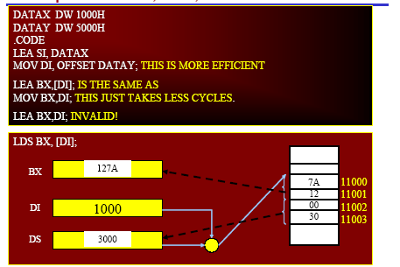
Examples for LEA, LDS, LES
LES similar to LDS except that it loads ES

Slide 13
Examples for LEA, LDS, LES
DATAX DW 1000H
DATAY DW 5000H
.CODE
LEA SI, DATAX
MOVE DI, OFFSET DATAY; THIS IS MORE EFFICIENT
LEA BX,[DI]; IS THE SAME AS
MOV BX,DI; THIS JUST TAKES LESS CYCLES.
LEA BX,DI; INVALID!
7A
12
00
30
LDS BX, [DI];
11000
11001
11002
11003
BX
127A
DI
1000
DS
3000
LES similar to LDS except that it loads ES

Slide 14
The XLAT Instruction
Mnemonic | Meaning | Format | Operation | Flags
XLAT | Translate | XLAT | ((AL)+(BX)+(DS)0) →(AL) | None
Example: Assume (DS) = 0300H, (BX)=0100H, and (AL)=0DH
XLAT replaces contents of AL by contents of memory location with
PA=(DS)0 +(BX) +(AL)
= 03000H + 0100H + 0DH = 0310DH
Thus
(0310DH) → (AL)

Slide 15
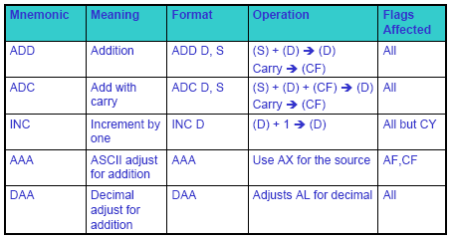
Arithmetic Instructions
ADD, ADC, INC, AAA, DAA
If the sum is >9, AH
is incremented by 1
Packed BCD

Slide 16
Arithmetic Instructions
ADD, ADC, INC, AAA, DAA
Mnemonic | Meaning | Format | Operation | Flags affected
ADD | Addition | ADD D,S | (S)+(D) (D) carry (CF) | ALL
ADC | Add with carry | ADC D,S | (S)+(D)+(CF) (D) carry (CF) | ALL
INC | Increment by one | INC D | (D)+1 (D) | ALL but CY
AAA | ASCII adjust for addition | AAA | If the sum is >9, AH is incremented by 1 | AF,CF
DAA | Decimal adjust for addition | DAA | Adjust AL for decimal Packed BCD | ALL

Slide 17
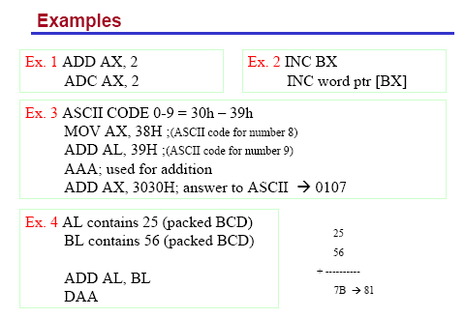
AL=71h
AH = 01, AL = 07
AX = 3137

Slide 18
Examples:
Ex.1 ADD AX,2
ADC AX,2
Ex.2 INC BX
INC WORD PTR [BX]
Ex.3 ASCII CODE 0-9 = 30-39h
MOV AX,38H; (ASCII code for number 8)
ADD AL,39H; (ASCII code for number 9) AL=71h
AAA; used for addition AH=01, AL=07
ADD AX,3030H; answer to ASCII 0107 AX=3137
Ex.4 AL contains 25 (packed BCD)
BL contains 56 (packed BCD)
ADD AL, BL
DAA
25
+ 56
--------
7B 81

Slide 19
Example:
.MODEL SMALL ; program that adds two multiword numbers:
.STACK 64
.DATA
DATA1 DQ 548F9963CE7h ;allocate 8 bytes
ORG 0010h
DATA2 DQ 3FCD4FA23B8Dh ; allocate 8 bytes
ORG 0020h
DATA3 DQ ?
.CODE
MAIN PROC FAR
MOV AX,@DATA ; receive the starting address for DATA
MOV DS,AX
CLC ; clear carry
MOV SI,OFFSET DATA1 ; LEA for DATA1
MOV DI,OFFSET DATA2 ; LEA for DATA2
MOV BX,OFFSET DATA3 ; LEA for DATA3
MOV CX,04h
BACK: MOV AX,[SI]
ADC AX,[DI] ; add with carry to AX
MOV [BX],AX
ADD SI,2h
ADD DI,2h
ADD BX,2h
LOOP BACK ; decrement CX automatically until zero
MOV AH,4Ch
INT 21h; halt
MAIN ENDP
END MAIN

Slide 20
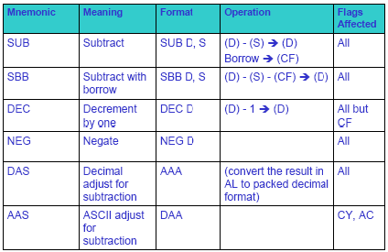
Arithmetic Instructions – SUB, SBB, DEC, AAS, DAS, NEG
CF=1
DAS
AAS
(AL) difference
(AH) dec by 1
if borrow
AAS

Slide 21
Arithmetic Instructions – SUB, SBB, DEC, AAS, DAS, NEG
Mnemonic | Meaning | Format | Operation | Flags affected
SUB | Subtract | SUB D,S | (D)-(S) (D) Borrow (CF) | All
SBB | Subtract with borrow | SBB D,S | (D)-(S)-(CF) (D) | All
DEC | Decrement by one | DEC D | (D)-1 (D) | All but CF
NEG | Negate | NEG D |  | All
DAS | Decimal adjust for subtraction | DAS | Convert the result in AL to packed decimal format | All
AAS | ASCII adjust for subtraction | AAS | (AL) difference (AH) dec by 1 if borrow | CY,AC

Slide 22
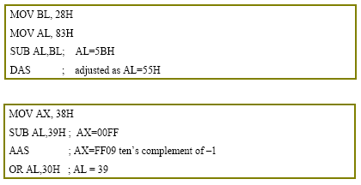
Examples: DAS
Borrow 1 from AH

Slide 23
Examples: DAS
MOV BL, 28H
MOV AL, 83H
SUB AL,BL; AL=5BH
DAS ; adjust as AL=55H
MOV AX, 38H
SUB AL,39H; AX=00FF
AAS ; AX=FF09 ten’s complement of -1(Borrow one from AH )
OR AL,30H ; AL=39

Slide 24
Assume (BX)=003AH, what is the result of executing the instruction
NEG BX
(BX)=0000000000111010
2’s comp = 1111111111000110 = FFC6H
(CF)=1

Slide 25
Example
• 32-bit subtraction of two 32 bit numbers X and Y that are stored in the memory as
X = (DS:203h)(DS:202h)(DS:201h)(DS:200h)
Y = (DS:103h)(DS:102h)(DS:101h)(DS:100h)
• The result X - Y to be stored where X is saved in the memory
MOV SI, 200h
MOV DI, 100h
MOV AX, [SI]
SUB AX, [DI]
MOV [SI], AX ;save the LS word of result
MOV AX, [SI] +2
SBB AX, [DI]+2
MOV [SI] +2, AX
Ex. 12 34 56 78 – 23 45 67 89 = EF EE EE EE

Slide 26
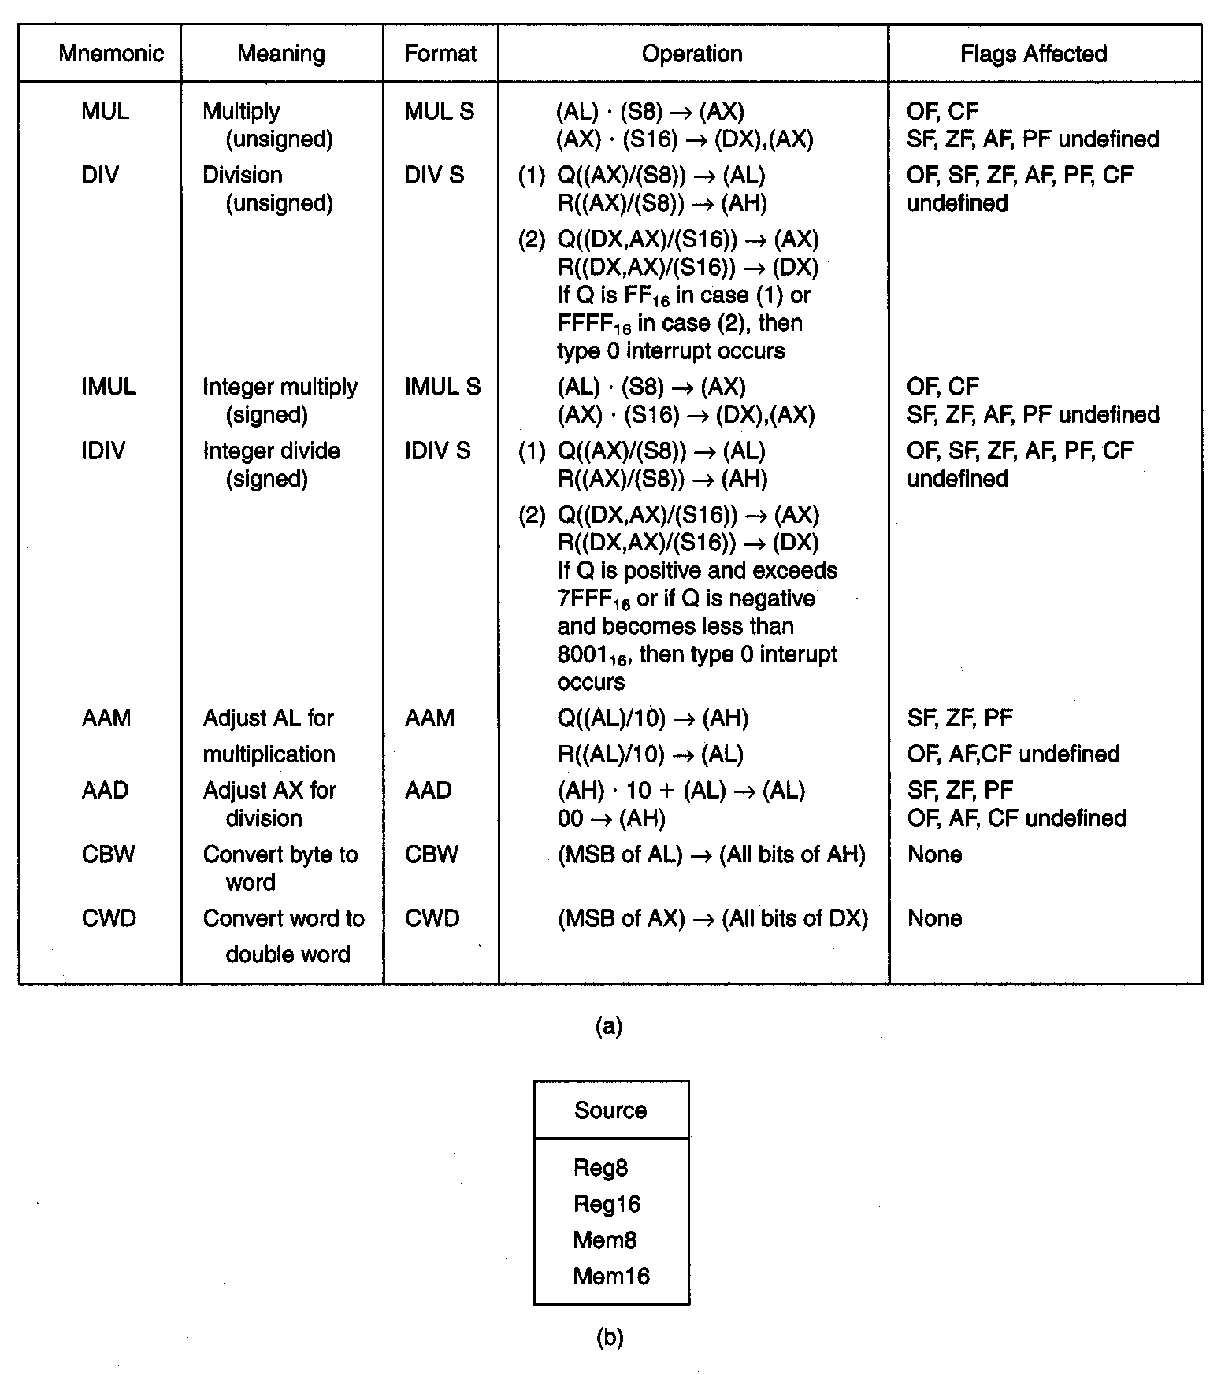
Multiplication and Division

Slide 27
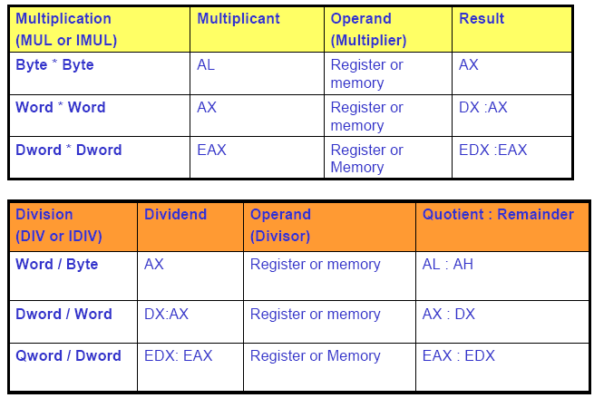
Multiplication and Division

Slide 28
Multiplication and Division
Multiplication (MUL or IMUL) | Multiplicant | Operand (Multiplier) | Result
Byte*Byte | AL | Register or memory | AX
Word*Word | AX | Register or memory | DX :AX
Dword*Dword | EAX | Register or memory | EAX :EDX
Division (DIV or IDIV) | Dividend | Operand (Divisor) | Quotient: Remainder
Word/Byte | AX | Register or Memory | AL : AH
Dword/Word | DX:AX | Register or Memory | AX : DX
Qword/Dword | EDX: EAX | Register or Memory | EAX : EDX

Slide 29

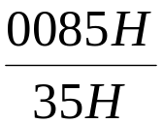

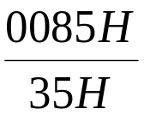
Multiplication and Division Examples
Ex1: Assume that each instruction starts from these values:
AL = 85H, BL = 35H, AH = 0H
1. MUL BL → AL . BL = 85H * 35H = 1B89H → AX = 1B89H
2. IMUL BL → AL . BL = 2’S AL * BL = 2’S (85H) * 35H
= 7BH * 35H = 1977H→ 2’s comp → E689H → AX.
3. DIV BL → = = 02 (85-02*35=1B) →
4. IDIV BL → = =
AH
AL
1B
02
AH
AL
1B | 02

Slide 30
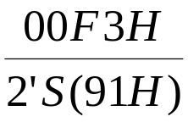
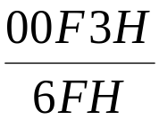
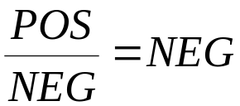
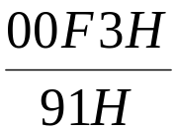
Ex2: AL = F3H, BL = 91H, AH = 00H
MUL BL → AL * BL = F3H * 91H = 89A3H → AX = 89A3H
IMUL BL → AL * BL = 2’S AL * 2’S BL = 2’S (F3H) * 2’S(91H) =
0DH * 6FH = 05A3H → AX.
3.IDIV BL → = = = 2→ (00F3 – 2*6F=15H)
AH AL
AH AL
15
02
→
→ 2’s(02) = FEH→
15
FE
R Q
AH AL
4. DIV BL → = = 01→(F3-1*91=62) →
62
01
R Q

Slide 31
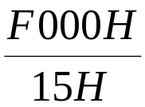
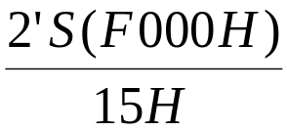
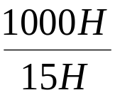
Ex3: AX= F000H, BX= 9015H, DX= 0000H
DX AX
1. MUL BX = F000H * 9015H =
8713
B000
DX AX
2. IMUL BX = 2’S(F000H) * 2’S(9015H) = 1000 * 6FEB =
06FE
B000
3. DIV BL = = B6DH → More than FFH → Divide Error.
4. IDIV BL → = = C3H > 7F → Divide Error.

Slide 32
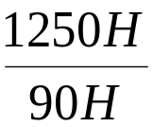
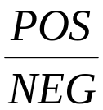
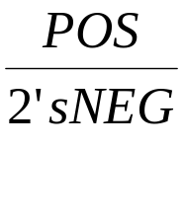
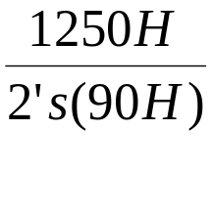
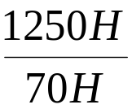
Ex4: AX= 1250H, BL= 90H
1. IDIV BL → = = = = =
= 29H (Q) → (1250 – 29 * 70) = 60H (REM)
R Q
29H ( POS) → 2’S (29H) = D7H →
60H
D7H
R Q
2. DIV BL → = = 20H→1250-20*90 =50H →
50H
20H
AH AL

Slide 33
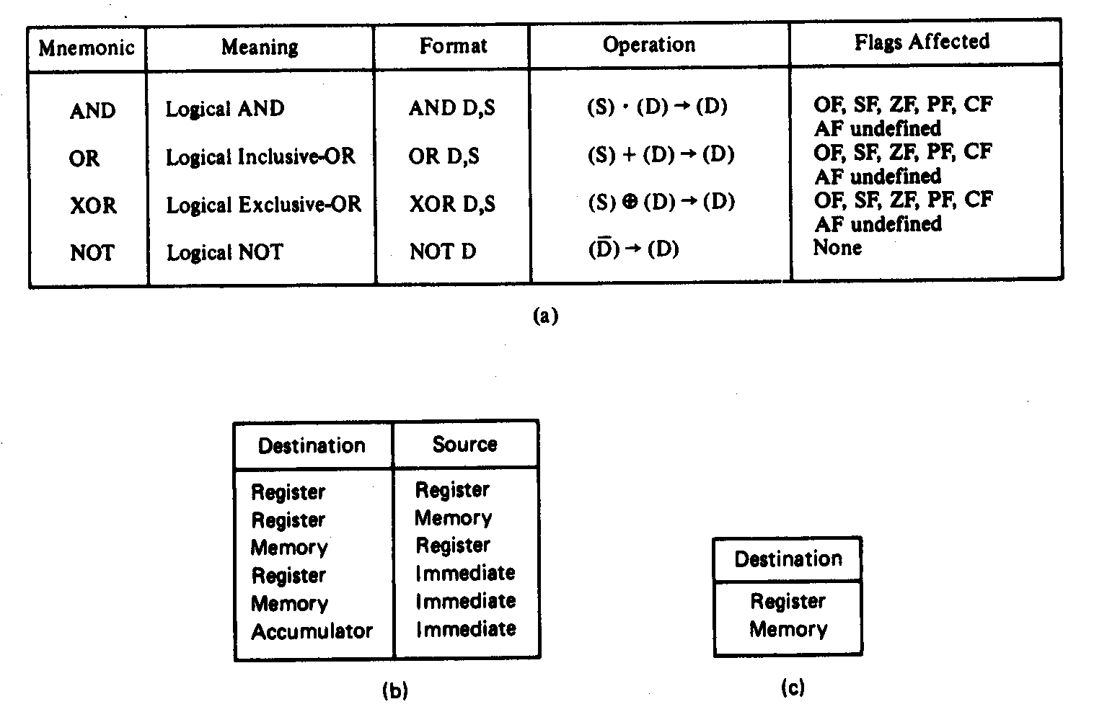
Logical Instructions

Slide 34
Logical Instructions
Mnemonic | Meaning | Format | Operation | Flags Affected
AND OR XOR NOT | Logical AND Logical Inclusive OR Logical Exclusive OR LOGICAL NOT | AND D,S OR D,S XOR D,S NOT D | (S) · (D) → (D) (S)+(D) → (D) (S) (D)→(D) _ (D) → (D) | OF, SF, ZF, PF, CF AF undefined OF, SF, ZF, PF, CF AF undefined OF, SF, ZF, PF, CF AF undefined None
+
Destination | Source
Register Register Memory Register Memory Accumulator | Register Memory Register Immediate Immediate Immediate
Destination
Register Memory

Slide 35
Logical Instructions
• AND
  – Uses any addressing mode except memory-to-memory and segment registers
  – Especially used in clearing certain bits (masking)
  xxxx xxxx AND 0000 1111 = 0000 xxxx
  (clear the first four bits)
  – Examples: AND BL, 0FH
  AND AL, [345H]
• OR
  – Used in setting certain bits
xxxx xxxx OR 0000 1111 = xxxx 1111
(Set the upper four bits)

Slide 36
XOR
    – Used in inverting bits
    xxxx xxxx XOR 0000 1111 = xxxxx’x’x’x’
    -Example: Clear bits 0 and 1, set bits 6 and 7, invert bit 5 of register CL:
      AND CL, OFCH ; 1111 1100B
      OR CL, 0C0H ; 1100 0000B
      XOR CL, 020H ; 0010 0000B

Slide 37
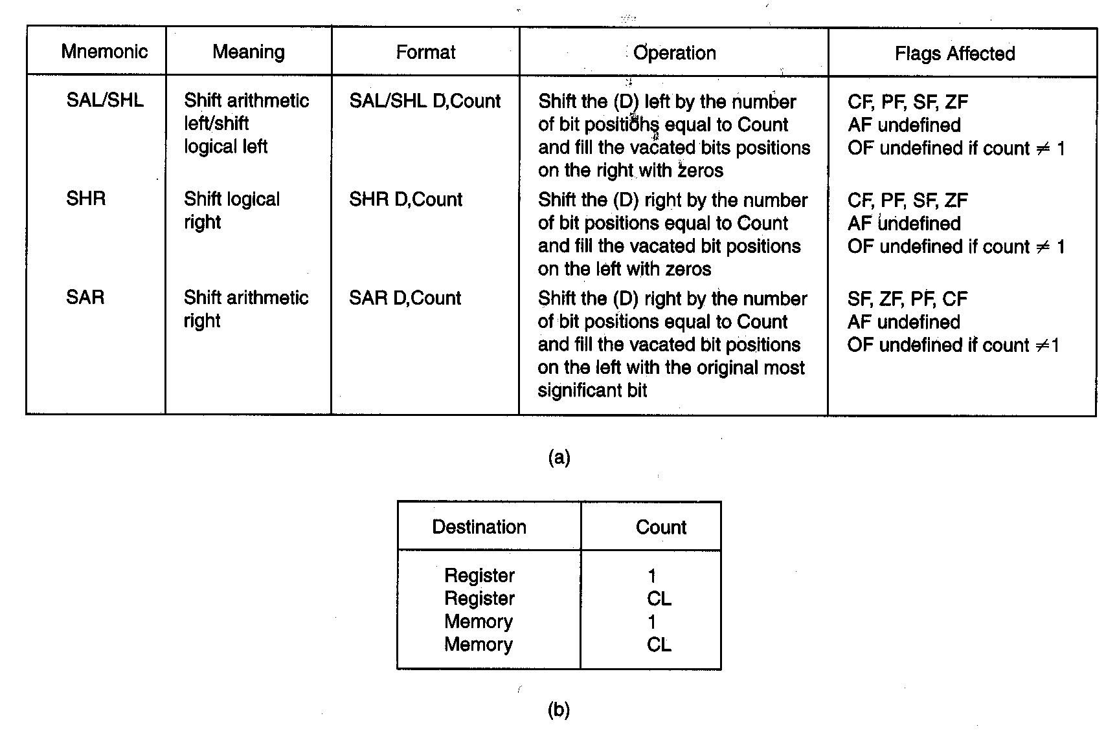
Shift Instructions

Slide 38
Shift Instructions
Mnemonic | Meaning | Format | Operation | Flags Affected
SAL/SHL SHR SAR | Shift arithmetic Left/shift Logical left Shift logical right Shift arithmetic right | SAL/SHL D,Count SHR D,Count SAR D,Count | Shift the (D) left by the number of bit positions equal to count and fill the vacated bits positions on the right with zeros Shift the (D) right by the number of bit positions equal to count and fill the vacated bits positions on the left with zeros Shift the (D) right by the number of bit positions equal to count and fill the vacated bits positions on the left with the original most significant bit | CF,PF,SF,ZF AF undefined OF undefined if count ≠1 CF,PF,SF,ZF AF undefined OF undefined if count ≠1 CF,PF,SF,ZF AF undefined OF undefined if count ≠1

Slide 39
Shift Instructions
Destination | Count
Register Register Memory Memory | 1 CL 1 CL

Slide 40
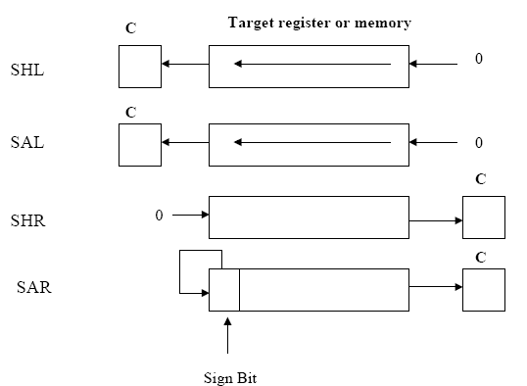

Slide 41
Ex.
      ; Multiply AX by 10
      SHL AX, 1
      MOV BX, AX
      MOV CL,2
      SHL AX,CL
      ADD AX, BX
Ex. What are the results of SAR CL, 1
  if CL initially contains B6H? DBH
Ex. What are the results of SHL AL, CL
if AL contains 75H and CL contains 3? A8H

Slide 42
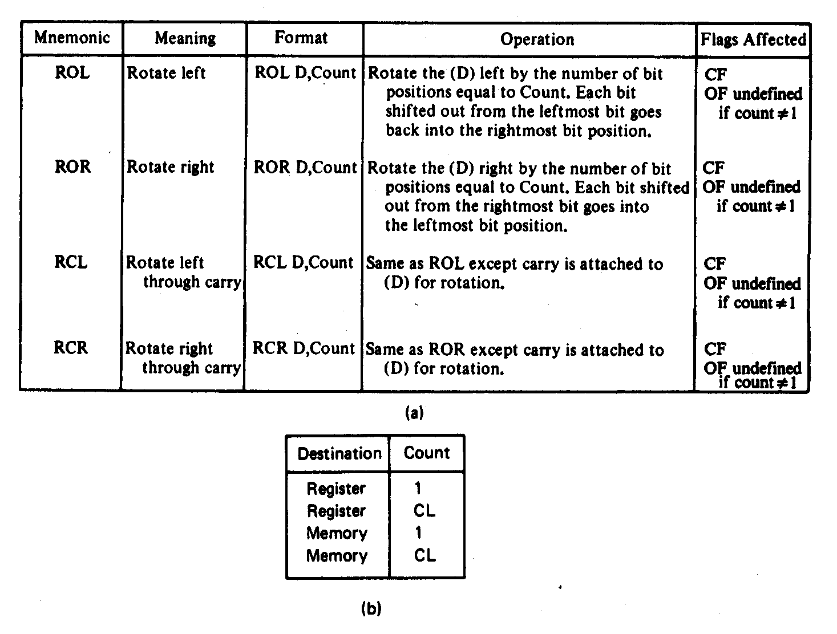
Rotate Instructions

Slide 43
Rotate Instructions
Mnemonic | Meaning | Format | Operation | Flags Affected
ROL | Rotate left | ROL D,Count | Rotate the (D) left by the number of bit positions equal to Count. Each bit shifted out from the left most bit goes back into the rightmost bit position. | CF OF undefined if count ≠ 1
ROR | Rotate right | ROR D,Count | Rotate the (D) right by the number of bit positions equal to Count. Each bit shifted out from the rightmost bit goes back into the leftmost bit position. | CF OF undefined if count ≠ 1
RCL | Rotate left through carry | RCL D,Count | Same as ROL except carry is attached to (D) for rotation. | CF OF undefined if count ≠ 1
RCR | Rotate right through carry | RCR D,Count | Same as ROR except carry is attached to (D) for rotation. | CF OF undefined if count ≠ 1

Slide 44
Rotate Instructions
Destination | Count
Register Register Memory Memory | 1 CL 1 CL

Slide 45
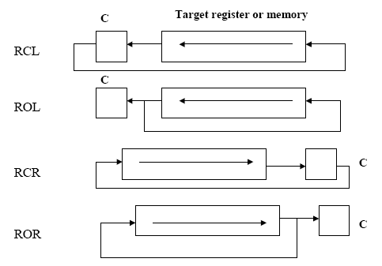
Ex. What is the result of ROL BTRE PTR [SI], 1
if SI is pointing to a memory location that contains 41H? (82H)

Slide 46
Example
Write a program that counts the number of 1’s in a
byte and writes it into BL
    DATA1 DB 97 ; 61h
    SUB BL, BL ; clear BL to keep the number of 1s
    MOV DL, 8 ; Counter
    MOV AL, DATA1
  AGAIN: ROL AL,1 ; rotate left once
    JNC NEXT ; check for 1
    INC BL ; if CF=1 then add one to count
    NEXT: DEC DL ; go through this 8 times
    JNZ AGAIN ; if not finished go back
    NOP

